Slide 1
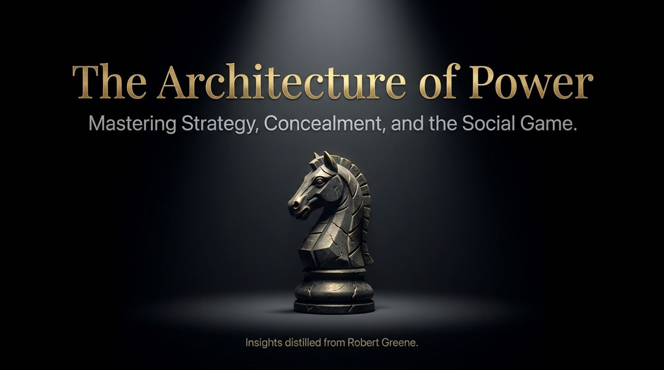
Notes:
Welcome everyone. Today we are diving into The Architecture of Power—a comprehensive guide to mastering strategy, concealment, and the intricate social dynamics that govern corporate and personal success.
Have you ever seen someone performing exceptionally well in an organization, delivering results, yet mysteriously getting sidelined, demoted, or fired? We often hear the phrase, "Just work hard and let your results speak for themselves." But in reality, meritocracy without social intelligence is a trap.
Drawing directly from the strategic philosophies of Robert Greene—author of The 48 Laws of Power—this presentation breaks down why raw performance isn't enough and how understanding power dynamics allows you to navigate organizational hierarchies safely and effectively.
https://www.youtube.com/watch?v=gnIL4xiWZa4

Slide 2
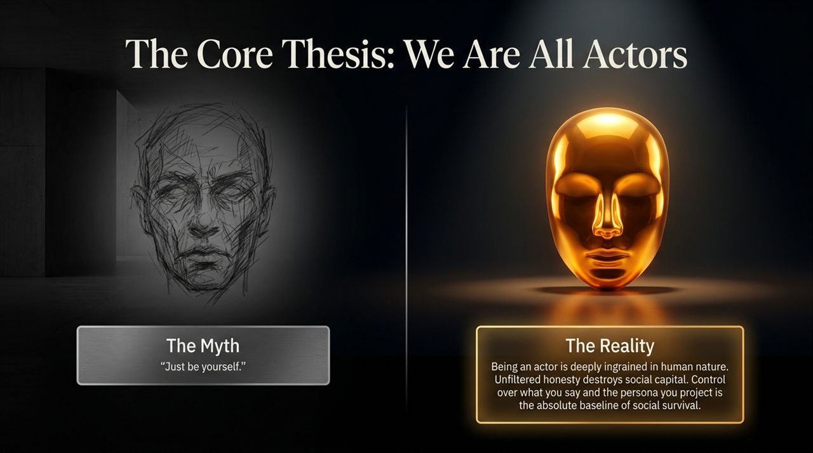
Notes:
Let's challenge a common modern myth: "Just be yourself" or "Always be 100% authentic."
As Robert Greene explains, acting and role-playing are deeply ingrained in human nature. Think back to early childhood—3 or 4 years old—where children intuitively act sweet or innocent to get candy or a toy. We are inherently social creatures, and unfiltered honesty destroys social capital.
If you said every single thought in your head—telling people their ideas are stupid or criticizing their appearance—you would alienate everyone around you instantly.
You act differently around your boss than you do with your closest friends. That isn't dishonesty; it's social survival and emotional self-control. Controlling what you say and the persona you project is the absolute baseline for navigating any social game.

Slide 3
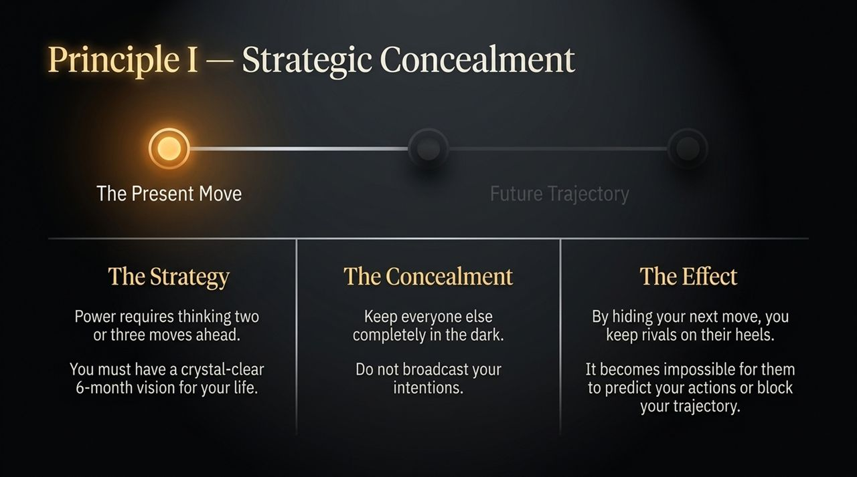
Notes:
True strategy requires thinking two or three moves ahead.
To succeed long-term, you must have a clear vision of where you want to be—whether 6 months, a year, or 5 years out. However, the critical rule of strategic power is to keep everyone else in the dark.
When you broadcast your intentions, you give rivals and opponents the opportunity to anticipate your trajectory, build defenses, or block your path.
By maintaining concealment, you keep your rivals on their heels. They cannot predict your actions, leaving you with the element of surprise and control over the strategic timeline.

Slide 4
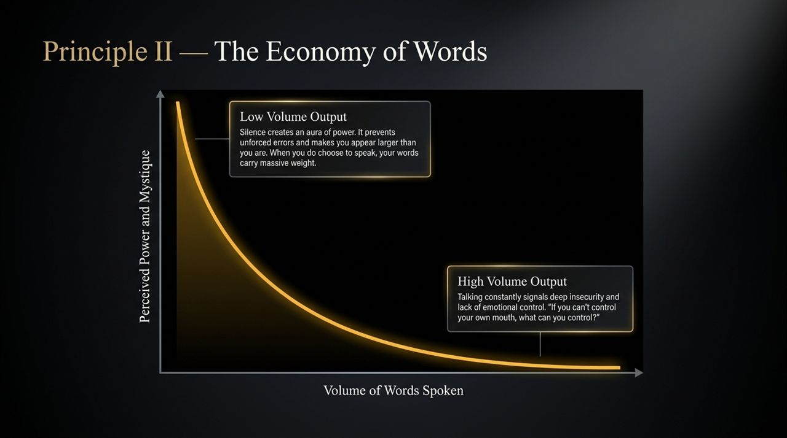
Notes:
Look at this inverse relationship curve between the volume of words spoken and perceived power.
High Volume Output: People who talk constantly often project deep insecurity and a lack of emotional control. As Greene notes, if you can't control your own mouth, people assume you can't control your emotions or behavior either. Talking too much increases unforced errors and leads to saying something careless.
Low Volume Output: Silence creates an aura of power and mystery. When you speak sparingly, your words carry immense weight. People lean in to listen because they know you don't waste breath.

Slide 5
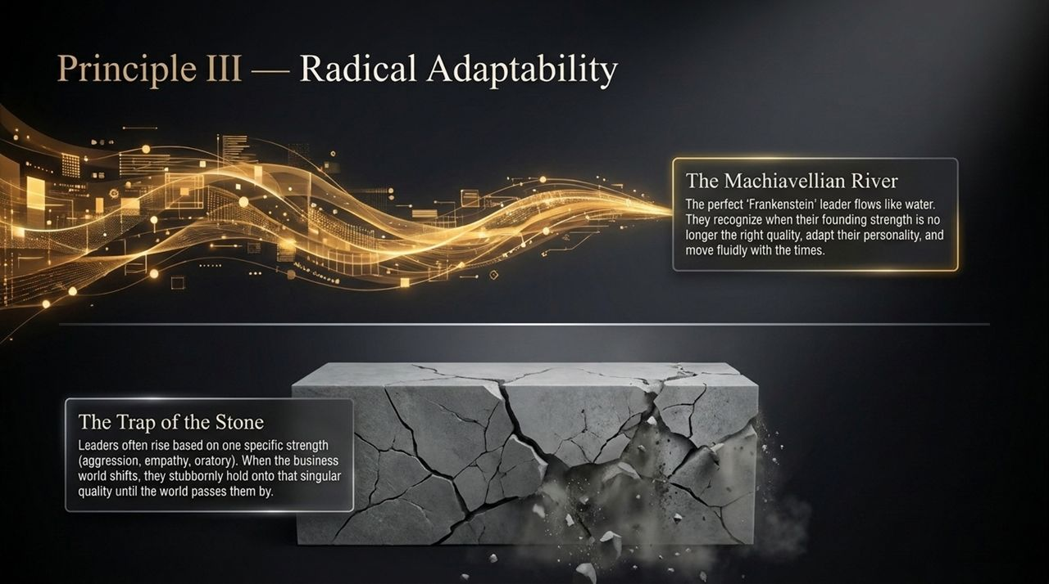
Notes:
Here we contrast two leadership archetypes: The Trap of the Stone vs. The Machiavellian River.
Leaders often rise to prominent positions based on a single core strength—aggression, empathy, oratory skill, or charisma. But when market trends shift, rigid leaders stubbornly hold onto that singular strength, assuming what worked in the past will work forever.
Machiavelli described the ideal leader like a river—flowing, shifting form, and adapting fluidly to changing landscapes.
To maintain true power, you must possess the self-awareness to abandon obsolete tactics and transform your approach as external environments evolve.

Slide 6
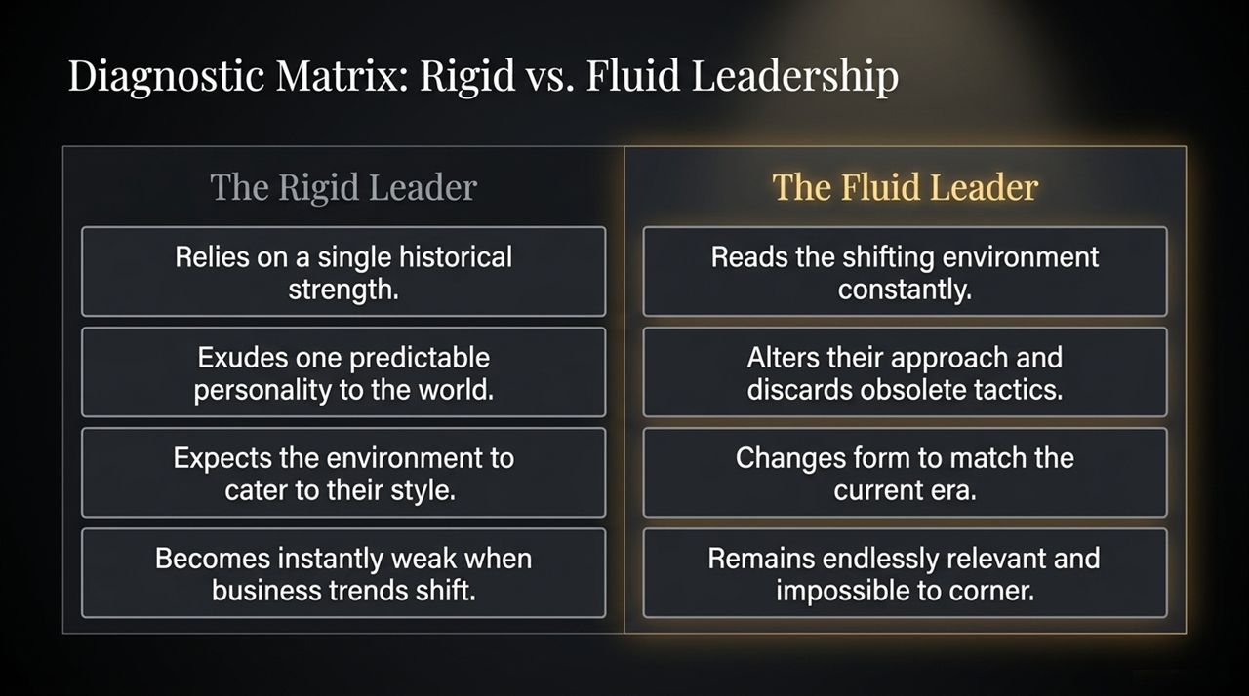
Notes:
Let's break down this diagnostic comparison between Rigid and Fluid leaders.
Rigid Leaders rely entirely on historical victories. They present one predictable personality to the world and expect the environment to cater to them. The moment business trends or competitive landscapes shift, they become vulnerable and easily outmaneuvered.
Fluid Leaders, by contrast, read shifting environments constantly. They discard strategies that no longer serve them and adapt their demeanor to match current needs. This adaptability makes them impossible to corner and perpetually relevant.

Slide 7
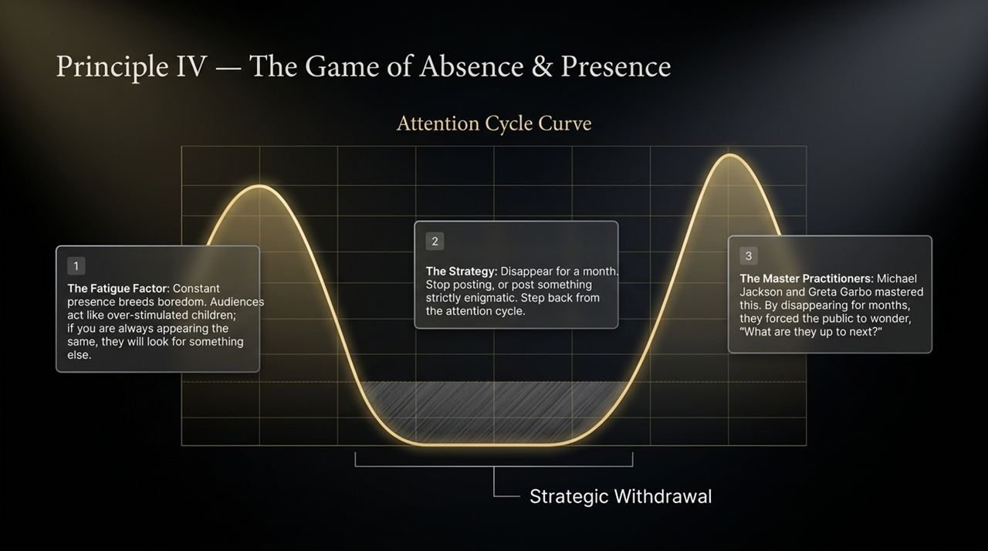
Notes:
Attention follows a natural fatigue cycle. Audiences and organizations get easily bored if you are constantly present and predictable—behaving like over-stimulated children always craving something new.
Strategic Withdrawal: By stepping back—disappearing for a period, pausing continuous posts, or adopting an enigmatic posture—you break the cycle of overexposure.
Greene points out how master practitioners like Michael Jackson, Greta Garbo, and Beyoncé mastered this dynamic. By strategically withdrawing from public sight, they created curiosity, forcing the public to speculate: "What are they working on next?"

Slide 8
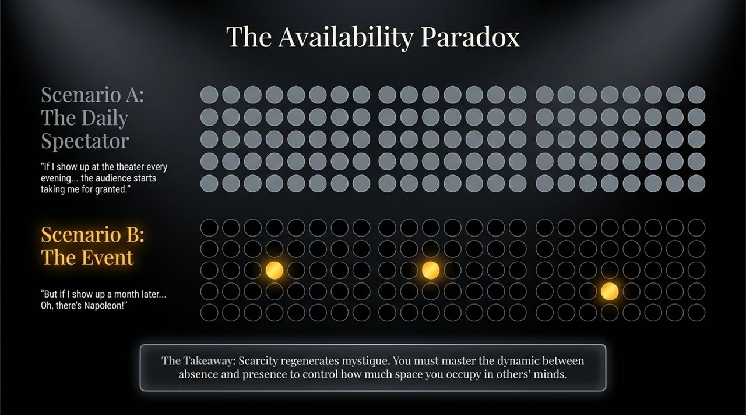
Notes:
This paradox is perfectly illustrated by Napoleon Bonaparte's rule of presence.
Napoleon noted: If he attended the theater every single evening, the public got used to seeing him, taking his presence for granted. But if he withdrew and appeared unexpectedly a month later, it created excitement and renewed prestige.
The Takeaway: Scarcity breeds value and regenerates mystique. Master the interplay between absence and presence to control your perceived value in others' minds.

Slide 9
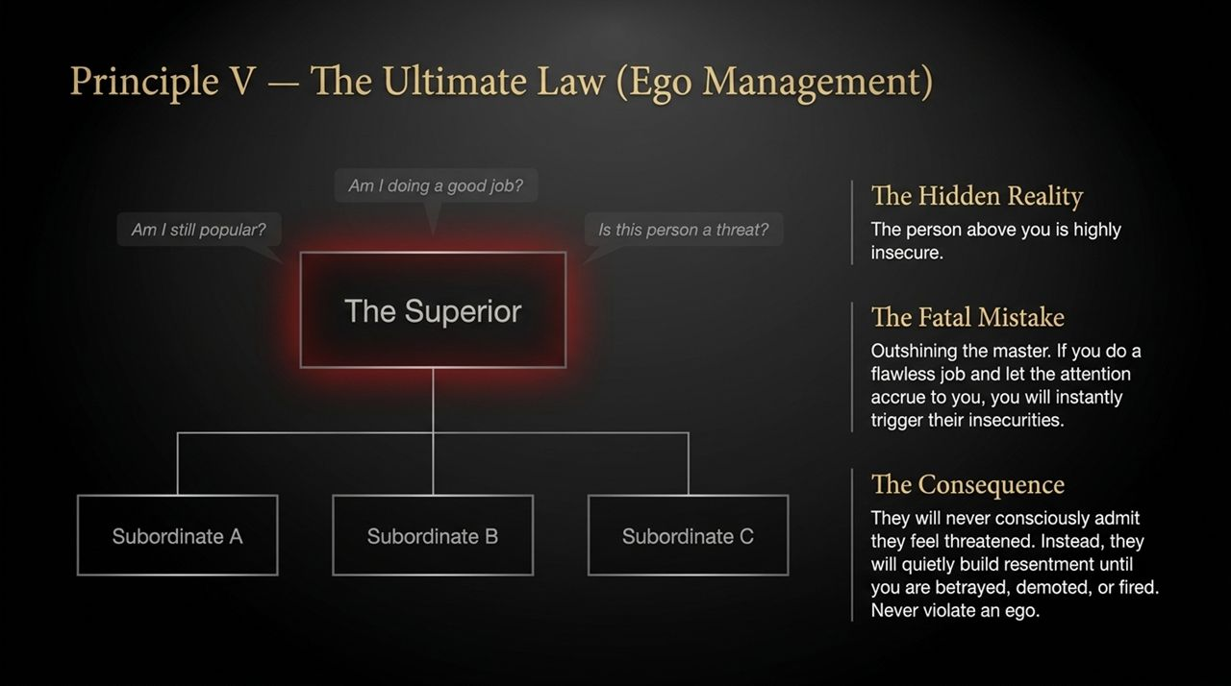
Notes:
This brings us to Law #1: Never Outshine the Master.
The person above you in a hierarchy—despite their title or authority—often harbors hidden insecurities. They continuously ask themselves: "Am I still popular? Is my position safe? Is this subordinate a threat?"
The Fatal Mistake: Performing flawlessly on a project and drawing all the praise and spotlight directly to yourself.
When you trigger a superior's insecurities, they won't openly admit feeling threatened. Instead, they build subconscious resentment, which ultimately leads to betrayal, demotion, or termination. Never violate a leader's ego.

Slide 10
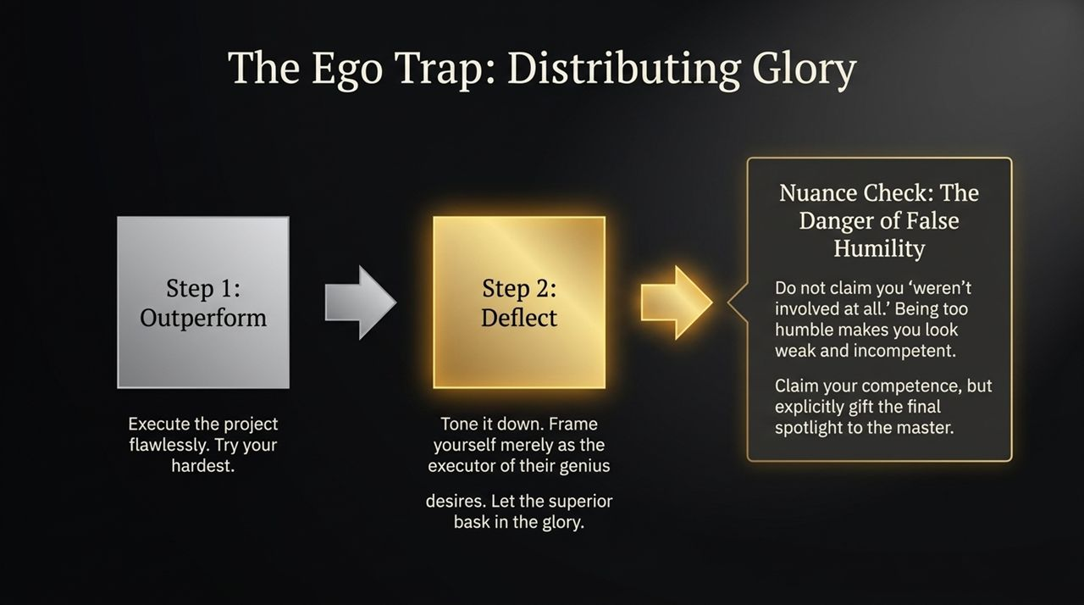
Notes:
How do you excel without triggering ego resentment? Follow two tactical steps:
Outperform: Work diligently and execute projects with high quality.
Deflect: Frame your execution as a realization of your leader's overarching vision, allowing them to share or bask in the spotlight.
Nuance Check: Avoid false humility or claiming complete non-involvement. Disclaiming your effort entirely makes you look weak and incompetent. Confidently establish your competence while generously attributing final strategic credit to your superior.

Slide 11
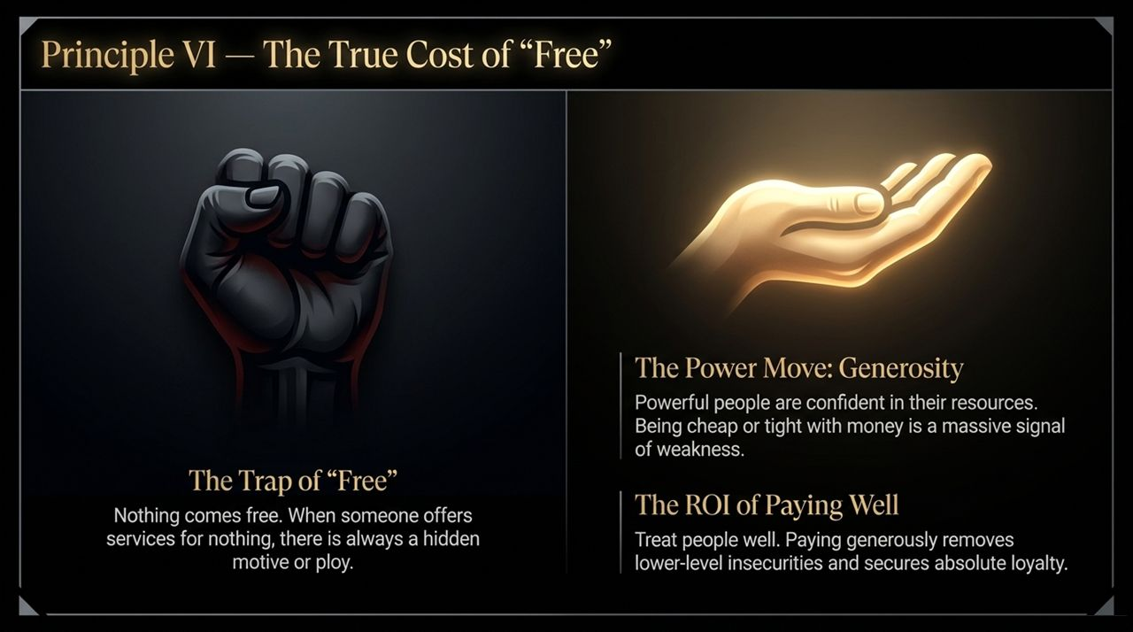
Notes:
In the game of power, nothing comes completely free. When someone offers favors or services for nothing, there is often a hidden agenda or ulterior motive.
Generosity as a Power Move: Powerful, confident individuals do not act tight-fisted with resources. Being overly cheap signals insecurity and weakness.
The ROI of Fair Compensation: Paying employees and partners generously removes lower-level financial anxiety, fosters trust, and builds long-term loyalty. Clear transactions prevent unspoken obligations.

Slide 12
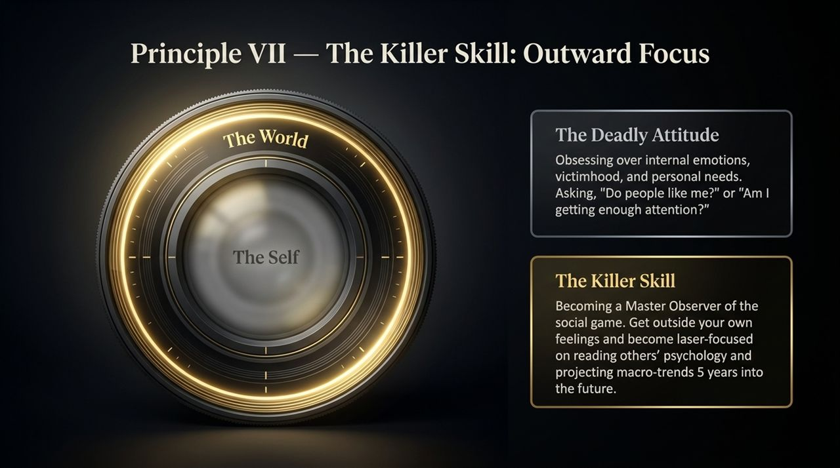
Notes:
The single most critical skill to master is shifting your attention outward.
The Deadly Attitude: Self-absorption—constantly obsessing over internal feelings, personal needs, victimhood, or asking "Do people like me?"
The Killer Skill: Becoming a master observer of social dynamics. Step away from internal anxieties and focus intensely on reading human psychology, understanding others' needs, and identifying macro-trends 5 years ahead.

Slide 13
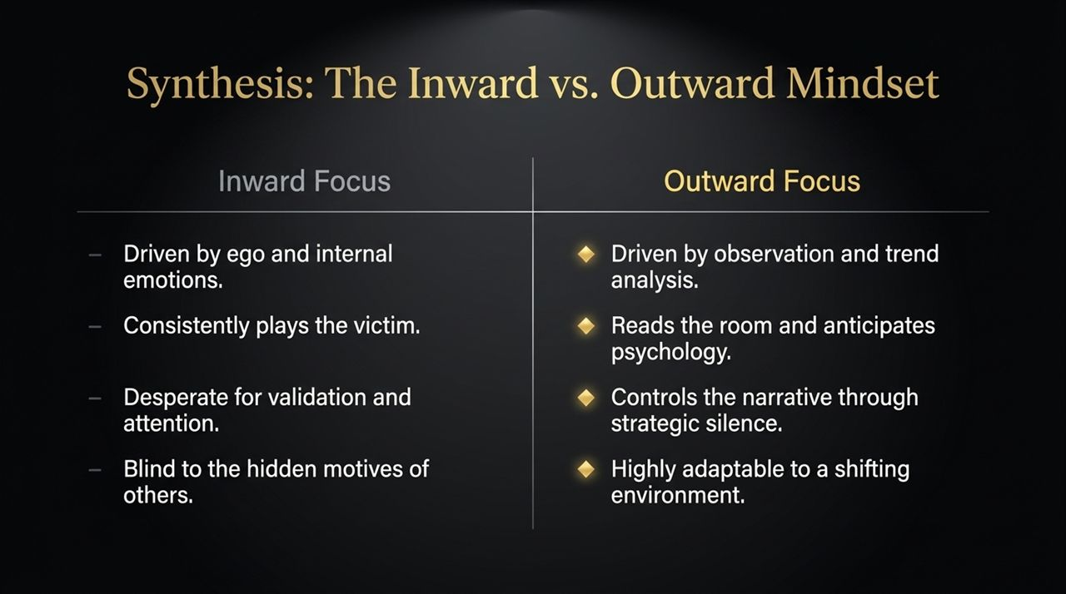
Notes:
Let's summarize the key differences between these two mindsets:
Inward Focus: Driven by fragile ego and raw emotion. Trapped in victimhood, constantly seeking external validation, and blind to underlying social dynamics.
Outward Focus: Driven by strategic observation and market analysis. Reads room dynamics, anticipates psychological needs, leverages strategic silence, and remains highly adaptable.

Slide 14
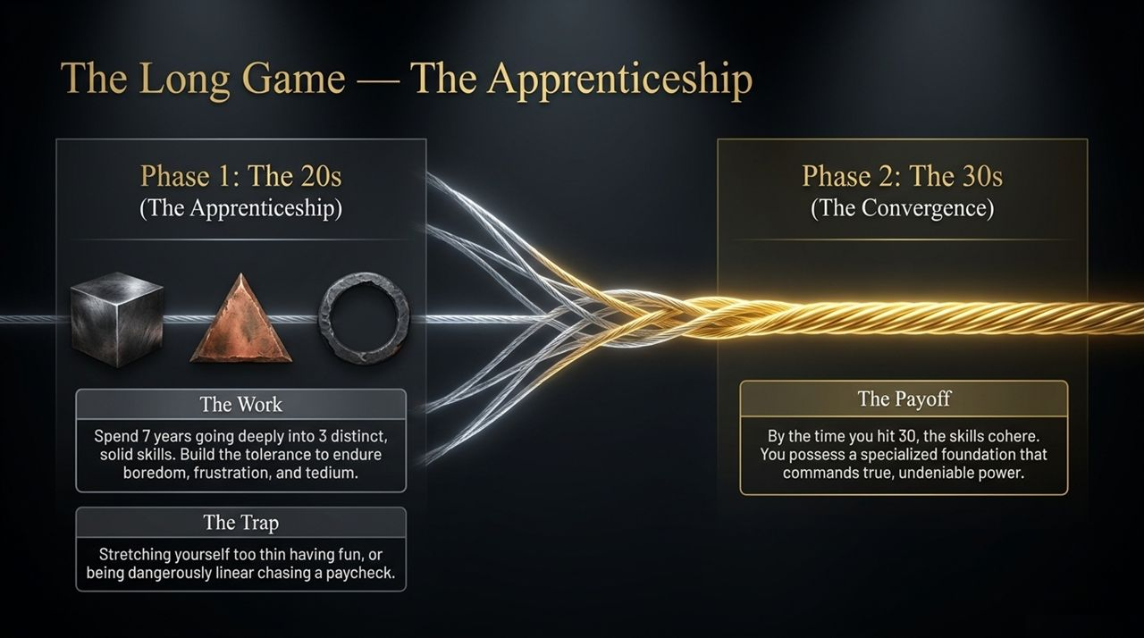
Notes:
Building lasting power requires patience across distinct career phases:
Phase 1: The 20s (Apprenticeship): Dedicate these years to mastering skills. Build a foundation by mastering 2 to 3 core competencies over 7 years. Develop the discipline to push through tedium, boredom, and frustration.
The Trap: Either scattering energy purely on short-term entertainment or remaining rigidly narrow solely chasing an immediate paycheck without developing broader skills.
Phase 2: The 30s (Convergence): By age 30, your accumulated skills synthesize into a powerful, specialized domain that commands genuine leverage.

Slide 15
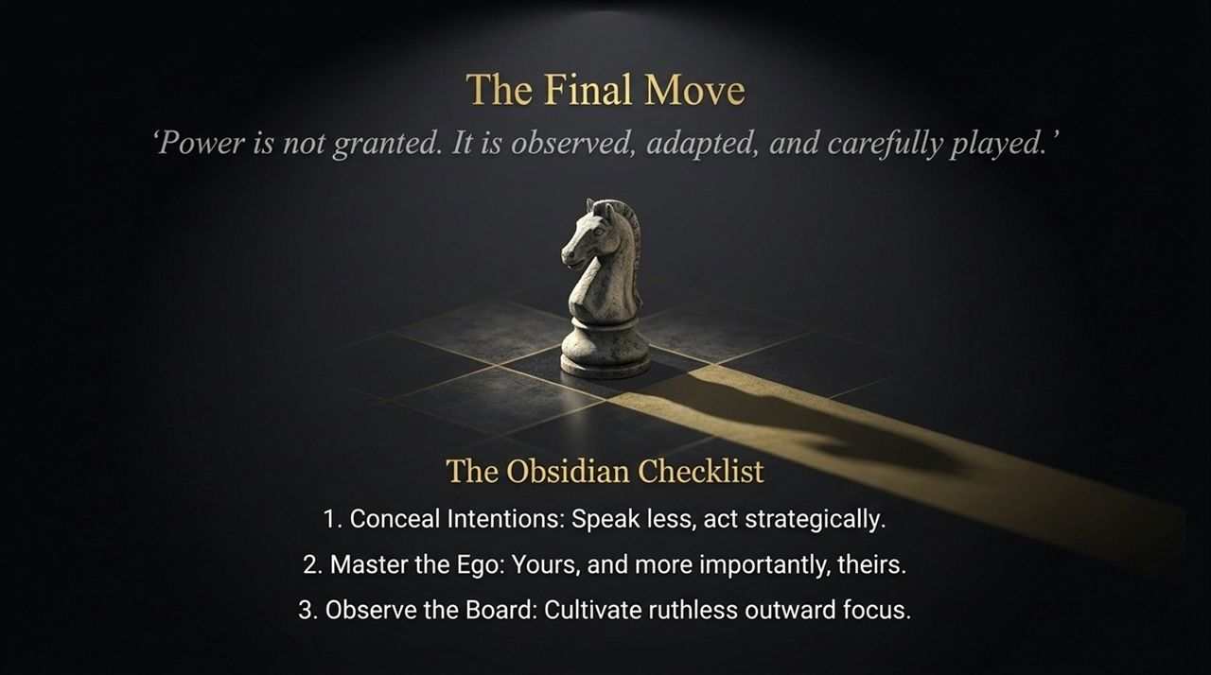
Notes:
To conclude: "Power is not granted. It is observed, adapted, and carefully played."
Keep The Obsidian Checklist top of mind for daily execution:
Conceal Intentions: Speak less, act deliberately, and keep future plans hidden.
Master the Ego: Protect your own emotional discipline, and never violate the egos of superiors or colleagues.
Observe the Board: Cultivate relentless outward focus to read social psychology and anticipate shifts.

Slide 16
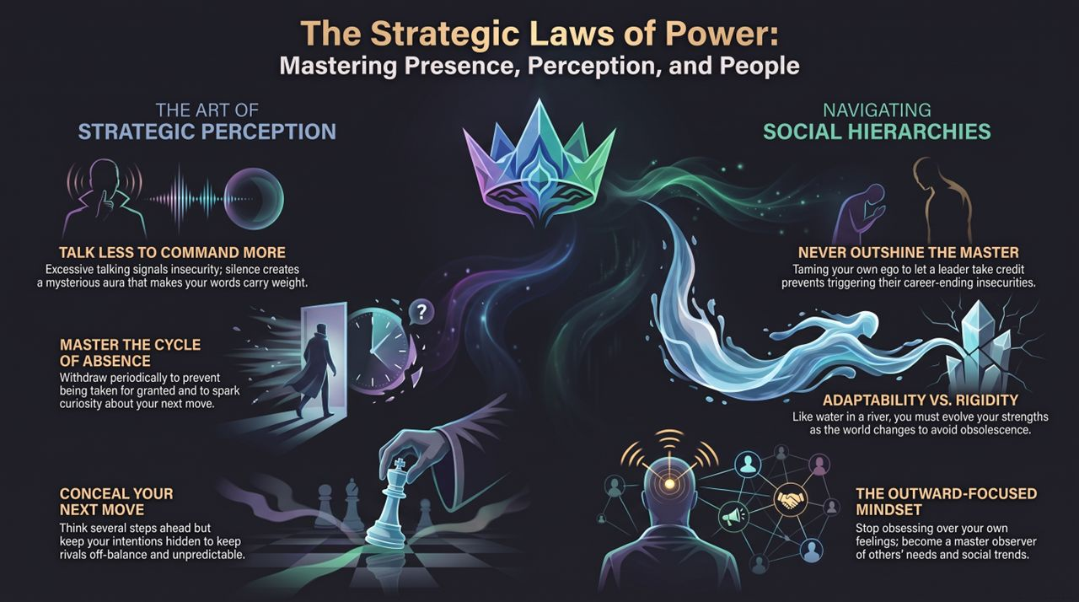
Notes:
Slide 16 ties together all six strategic pillars into a clear framework:
Talk Less to Command More: Silence builds mystique; excessive talk conveys insecurity.
Never Outshine the Master: Manage superiors' egos to safeguard your position.
Master the Cycle of Absence: Use strategic distance to regenerate presence and authority.
Conceal Your Next Move: Keep your tactical plans protected.
Adaptability vs. Rigidity: Flow like water to remain relevant.
Outward-Focused Mindset: Observe external reality rather than inner emotional noise.
https://www.youtube.com/watch?v=gnIL4xiWZa4

